Slide 1






Data Aggregation
How to get data insights?
Databases
Basics
SoftUni Team
Technical Trainers
Software University
http://softuni.bg

Slide 2

Table of Content
Grouping
Aggregate Functions
Having Clause
Pivot Tables

Slide 3
Questions
sli.do #CSharpDB

Slide 4
Grouping
Consolidating data based on criteria

Slide 5
Grouping (1)
Grouping allows taking data into separate groups based on a common property
Employee | DepartmentName | Salary
Adam
Database Support
5,000
John
Database Support
15,000
Jane
Application Support
10,000
George
Application Support
15,000
Lila
Application Support
5,000
Fred
Software Support
15,000

Slide 6
Grouping (1)
Grouping column
Employee | DepartmentName | Salary
Adam
Database Support
5,000
Can be aggregated
Single row
John
Database Support
15,000
Jane
Application Support
10,000
George
Application Support
15,000
Lila
Application Support
5,000
Fred
Software Support
15,000

Slide 7
Grouping (2)
With GROUP BY you can get each separate group and use an "aggregate" function over it (like Average, Min or Max):
With DISTINCT you will get all unique values:
SELECT e.DepartmentID
FROM Employees AS e
GROUP BY e.DepartmentID
Grouping
Columns
SELECT DISTINCT e.DepartmentID FROM Employees AS e
Unique Values
Notes:
When we use GROUP BY we can easily achieve distinct values. Grouping leaves only the unique combination of values.
Using the keyword DISTINCT is another way to eliminate the duplicate values. It simplifies the syntax because we don’t have to write down every single column in the GROUP BY part.

Slide 8
Problem: Departments Total Salaries
Use "SoftUni" database to create a query which prints the total sum of salaries for each department.
Order them by DepartmentID (ascending).
Employee | DepartmentID | Salary
Adam | 1 | 5,000
John | 1 | 15,000
Jane | 2 | 10,000
George | 2 | 15,000
Lila | 2 | 5,000
Fred | 3 | 15,000
DepartmentID | TotalSalary
1 | 20,000
2 | 30,000
3 | 15,000
Check your solution here: https://judge.softuni.bg/Contests/Practice/Index/291#12
Notes:
Use grouping to aggregate data. In order to achieve aggregation you need columns that will define the groups. In the case above we will use DepartmentID for aggregation purposes. The column has 3 unique values: “1”, “2” and “3”. Therefore, we will have 3 groups. Moreover, we can sum the salaries of the employees in those departments. If we add the Employee column we will have 6 groups because we have 6 unique combinations of values.

Slide 9
Solution: Departments Total Salaries
After grouping every employee by it's department we can use aggregate function to calculate total amount of money per group.
Grouping Column
Column Alias
SELECT e.DepartmentID,
SUM(e.Salary) AS TotalSalary
FROM Employees AS e
GROUP BY e.DepartmentID
ORDER BY e.DepartmentID
Table Alias
Grouping Column
Check your solution here: https://judge.softuni.bg/Contests/Practice/Index/291#12
Notes:
SQL provides the functionality by the statement GROUP BY. It is mandatory to have all the columns from the SELECT part in the GROUP BY part. On the other hand, it is possible to have columns in GROUP BY part but not in SELECT part. In this case the groups will be the same as if it was in the SELECT part but the missing columns wouldn’t be visualized.

Slide 10

Aggregate Functions
COUNT, SUM, MAX, MIN, AVG…

Slide 11
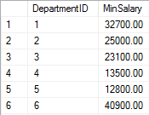
Aggregate Functions
Operate over (non-empty) groups
Perform data analysis on each one
MIN, MAX, AVG, COUNT etc.
Aggregate functions usually ignore NULL values.
SELECT e.DepartmentID,
MIN(e.Salary) AS MinSalary
FROM Employees AS e
GROUP BY e.DepartmentID

Slide 12
Aggregate Functions: COUNT
COUNT - count the values in one or more grouped columns
Ignores null values
Employee | DepartmentName | Salary
Adam | Database Support | 5,000
John | Database Support | 15,000
Jane | Application Support | 10,000
George | Application Support | 15,000
Lila | Application Support | 5,000
Fred | Software Support | 15,000
DepartmentName | SalaryCount
Database Support | 2
Application Support | 3
Software Support | 1
Notes:
If any of the values are NULL they are ignored. For example, if one the values is NULL and the other is 5,000 the COUNT will return 1 because it will ignore the NULL value. On the other hand, we can count everything by writing COUNT(*).

Slide 13
COUNT Syntax
Grouping Column
COUNT(ColumnName)
Note: COUNT ignores any employee with NULL salary.
New Column Alias
SELECT e.DepartmentID,
COUNT(e.Salary) AS SalaryCount
FROM Employees AS e
GROUP BY e.DepartmentID
Grouping Columns

Slide 14
Aggregate Functions: SUM
SUM - sums the values in a column.
Employee | DepartmentName | Salary
Adam | Database Support | 5,000
John | Database Support | 15,000
Jane | Application Support | 10,000
George | Application Support | 15,000
Lila | Application Support | 5,000
Fred | Software Support | 15,000
DepartmentName | TotalSalary
Database Support | 20,000
Application Support | 30,000
Software Support | 15,000

Slide 15
SUM Syntax
If any department has no salaries, it returns NULL.
Grouping Column
New Column Alias
SELECT e.DepartmentID,
SUM(e.Salary) AS TotalSalary
FROM Employees AS e
GROUP BY e.DepartmentID
Table Alias
Grouping Columns

Slide 16
Aggregate Functions: MAX
MAX - takes the largest value in a column.
Employee | DepartmentName | Salary
Adam | Database Support | 5,000
John | Database Support | 15,000
Jane | Application Support | 10,000
George | Application Support | 15,000
Lila | Application Support | 5,000
Fred | Software Support | 15,000
DepartmentName | MaxSalary
Database Support | 15,000
Application Support | 15,000
Software Support | 15,000
Notes:
NULLs are ignored again.

Slide 17
MAX Syntax
Grouping Column
New Column Alias
SELECT e.DepartmentID, MAX(e.Salary) AS MaxSalary
FROM Employees AS e
GROUP BY e.DepartmentID
Table Alias
Grouping Columns

Slide 18
Aggregate Functions: MIN
MIN takes the smallest value in a column.
Employee | DepartmentName | Salary
Adam | Database Support | 5,000
John | Database Support | 15,000
Jane | Application Support | 10,000
George | Application Support | 15,000
Lila | Application Support | 5,000
Fred | Software Support | 15,000
DepartmentName | MinSalary
Database Support | 5,000
Application Support | 5,000
Software Support | 15,000

Slide 19
MIN Syntax
Grouping Column
New Column Alias
SELECT e.DepartmentID, MIN(e.Salary) AS MinSalary
FROM Employees AS e
GROUP BY e.DepartmentID
Table Alias
Grouping Columns

Slide 20
Aggregate Functions: AVG
AVG calculates the average value in a column.
Employee | DepartmentName | Salary
Adam | Database Support | 5,000
John | Database Support | 15,000
Jane | Application Support | 10,000
George | Application Support | 15,000
Lila | Application Support | 5,000
Fred | Software Support | 15,000
DepartmentName | AvgSalary
Database Support | 10,000
Application Support | 10,000
Software Support | 15,000

Slide 21
AVG Syntax
Grouping Column
New Column Alias
SELECT e.DepartmentID,
AVG(e.Salary) AS AvgSalary
FROM Employees AS e
GROUP BY e.DepartmentID
Table Alias
Grouping Columns

Slide 22
Having
Using predicates while grouping
Notes:
The HAVING clause is used to filter data based on aggregate values. This means that we cannot use it without grouping before that. Unlike HAVING, the WHERE clause filters rows before the aggregation happens.

Slide 23
Having Clause
The HAVING clause is used to filter data based on aggregate values
We cannot use it without grouping first
Aggregate functions (MIN, MAX, SUM etc.) are executed only once
Unlike HAVING, WHERE filters rows before aggregation

Slide 24
HAVING Clause: Example
Filter departments having total salary more than or equal to 15,000
Aggregated value
Employee | DepartmentName | Salary
Adam | Database Support | 5,000
John | Database Support | 15,000
Jane | Application Support | 1,000
George | Application Support | 5,000
Lila | Application Support | 5,000
Fred | Software Support | 15,000
TotalSalary
20,000
11,000
15,000
DepartmentName | TotalSalary
Database Support | 20,000
Software Support | 15,000

Slide 25
HAVING Syntax
Grouping Column
Aggregate Function
Column Alias
SELECT e.DepartmentID, SUM(e.Salary) AS TotalSalary
FROM Employees AS e
GROUP BY e.DepartmentID
HAVING SUM(e.Salary) < 250000
Grouping Columns
Having Predicate

Slide 26
Logical vs Physical Execution
Execution Order | Logical Execution | Physical Execution
1 | SELECT | FROM
2 | DISTINCT | ON
3 | TOP | OUTER
4 | FROM | WHERE
5 | ON | GROUP BY
6 | OUTER | HAVING
7 | WHERE | SELECT
8 | GROUP | DISTINCT
9 | HAVING | ORDER BY
10 | ORDER BY | TOP/LIMIT
Notes:
Now that we know more about querying it is important to understand how SQL works. There is a difference between the syntax and the execution. If we have the following query: SELECT DISTINCT
u.user_name,
c.name AS character_name,
SUM(cash) AS total_cash
FROM users_games ug
INNER JOIN characters c
ON ug.character_id = c.id
INNER JOIN users u
ON ug.user_id = u.id GROUP BY u.user_name, c.name
HAVING SUM(cash) > 10000
ORDER BY total_cash
LIMIT 10 The following execution will happen: First we are going to read FROM the table. Then we will join tables ON some criteria and do the OUTER joins. Afterwards come the filtering with WHERE. Then we GROUP by the columns. Furthermore, we will filter aggregated data by using HAVING. The next step is to SELECT the data we want. After that we can get DISTINCT records which we can ORDER. At the end we can LIMIT the dataset.

Slide 27
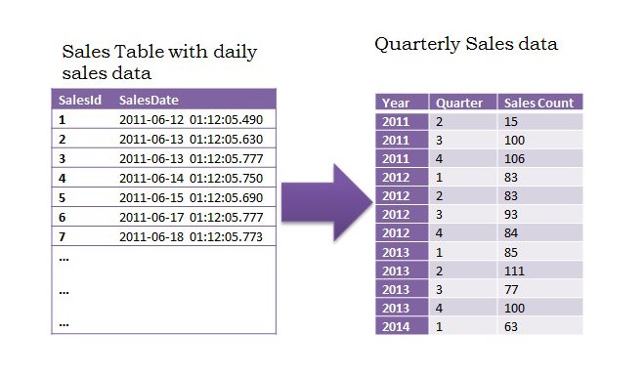
Pivot Tables

Slide 28
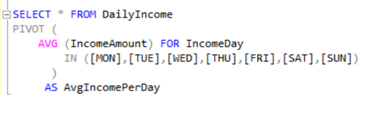
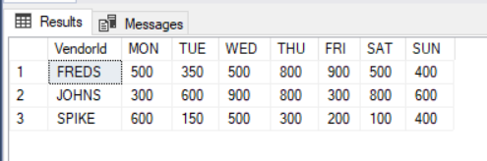
Pivot Tables
Summarizes data from another table
Applies an aggregate operation
(sorting, averaging, summing, etc…)
Typically includes grouping of the data.

Slide 29

Summary
Grouping by Shared Properties
Aggregate Functions
Having Clause
Pivot Tables
SELECT
SUM(e.Salary) AS 'TotalSalary'
FROM Employees AS e
GROUP BY e.DepartmentID
HAVING SUM(e.Salary) < 250000
Databases

Slide 30







Data Aggregation
https://softuni.bg/courses/databases-basics-ms-sql-server

Slide 31






SoftUni Diamond Partners

Slide 32






SoftUni Diamond Partners

Slide 33
License
This course (slides, examples, demos, videos, homework, etc.) is licensed under the "Creative Commons Attribution-NonCommercial-ShareAlike 4.0 International" license
Attribution: this work may contain portions from
"Databases" course by Telerik Academy under CC-BY-NC-SA license

Slide 34





Trainings @ Software University (SoftUni)
Software University – High-Quality Education, Profession and Job for Software Developers
softuni.bg
Software University Foundation
http://softuni.foundation/
Software University @ Facebook
facebook.com/SoftwareUniversity
Software University Forums
forum.softuni.bg

